Slide 1

Title : Next-Gen Resume Builder: From Skills to Career
Student Name : Ch. Sai Vihamsh
Cluster : 1
Section : 4
Under the guidance
Of
Supervisor Name:

Slide 2
Abstract
The Next‑Gen Resume Builder is a web-based application that helps students and job seekers create professional resumes quickly.
Users can enter their personal details, education, skills, projects, and achievements through a simple form interface.
The system automatically generates a well‑structured resume preview in real time.
Users can edit information instantly and view the updated resume layout dynamically.
The application is developed using HTML, CSS, and JavaScript to provide an interactive and responsive experience.
This system simplifies resume creation and helps users prepare professional resumes efficiently.

Slide 3
Existing System
Most students prepare resumes manually using text editors or basic templates.
Designing resumes manually takes time and requires formatting knowledge.
Users often face issues with layout alignment and proper structure.
Updating resume information repeatedly is difficult.
Many resumes look unprofessional due to poor formatting.
There is no automatic preview or dynamic resume generation system.

Slide 4
Proposed System
The proposed system is a Smart Resume Builder that automatically generates resumes.
Users enter details such as name, education, skills, and projects using a form.
The system instantly generates a structured resume preview.
Users can edit and update their information dynamically.
The system provides a professional layout and organized sections.
It reduces time and helps students create resumes easily without design skills.

Slide 5
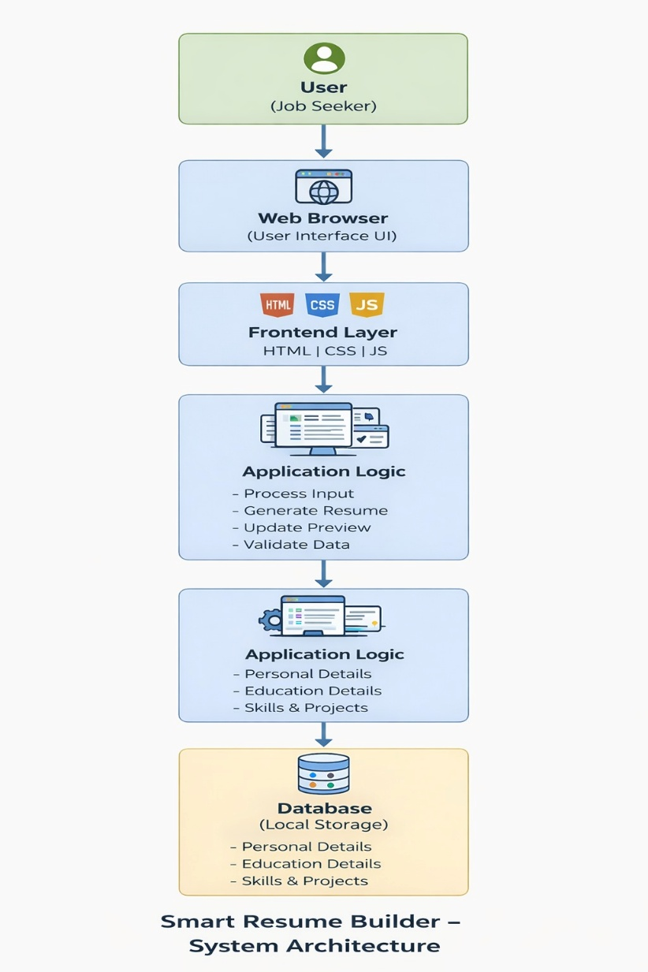
System Architecture
User: Enters personal, educational, and skill information.
Web Browser: Opens the Resume Builder application.
Frontend (HTML, CSS, JavaScript):
Displays the input form and resume preview layout.
JavaScript Logic:
Processes user data and dynamically updates the resume output.

Slide 6
Project Modules
User Input Module
Users enter personal information, education, and skills.
Resume Generation Module
Automatically creates a structured resume layout.
Preview Module
Displays resume preview in real time.
Edit Module
Allows users to update and modify details easily.
Download/Print Module
Users can download or print the generated resume.

Slide 7
Objectives
To develop a web‑based Smart Resume Builder.
To simplify resume creation for students and job seekers.
To automatically generate a structured resume format.
To allow real‑time preview and editing of resume details.
To provide a user‑friendly interface for creating professional resumes.

Slide 8
CO's Attainments - FWD
CO-1 (Internet + HTML/CSS)
Static HTML pages (login, dashboard, etc.) use proper document structure and links.
CSS provides layout, typography, colors, spacing, and basic hover/transition effects.
CO-2 (Forms + Semantic + Layouts)
Login/registration forms with inputs and basic validation messages.
Structured layouts using header/menu/container; tables for lists; images via <img>.
CSS includes flex layout, transitions, and shared variables.
CO-3 (JS Essentials)
JS uses functions, conditionals, objects/arrays, and array methods.
Handles login/register logic and book list processing.
CO-4 (DOM & Interactivity)
Shows/hides sections, updates page content, and responds to clicks/typing.
Uses localStorage for persisting data (login state, books).

Slide 9
Course Outcome 5 (Advanced + Deployment)
Basic input validation and error messages.
App is deployable as static site; can be improved with modules, meta tags, and API integration.

Slide 10
CO's Attainments - DSA
Searching (Linear Search) Implemented using array methods like find(), filter(), and some(). Used for login checks, duplicate email checking, finding books/students by ID, and borrow/return status checks.
List ADT (Array-based) Main data is stored as lists: students, books, issuedBooks. Core list operations are used: Add (push) Delete (filter) Update (edit record fields) Traverse (forEach)
Basic Algorithmic Flow (Practical) Most features follow: Input → Validate → Search → Update → Save → Display
Applied in registration, login, issue book, return book, and admin management actions.
Persistent Data Handling Lists are stored in localStorage using JSON. Shows practical data structure usage with save/load/update across sessions.

Slide 11
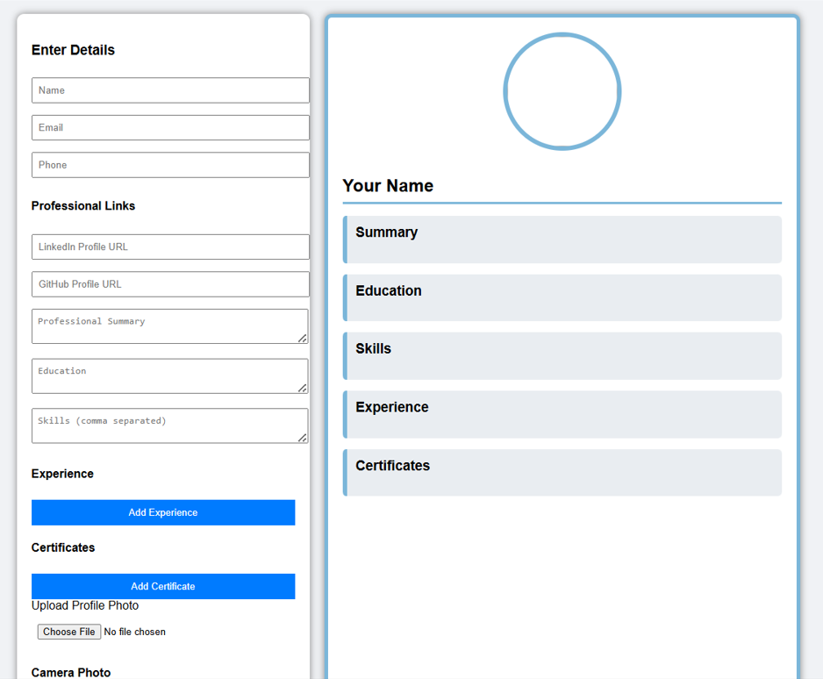
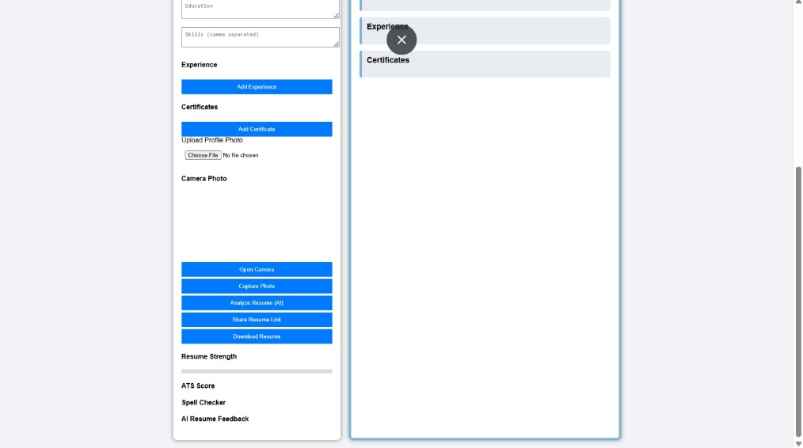
Screenshots for FWD & DSA

Slide 12
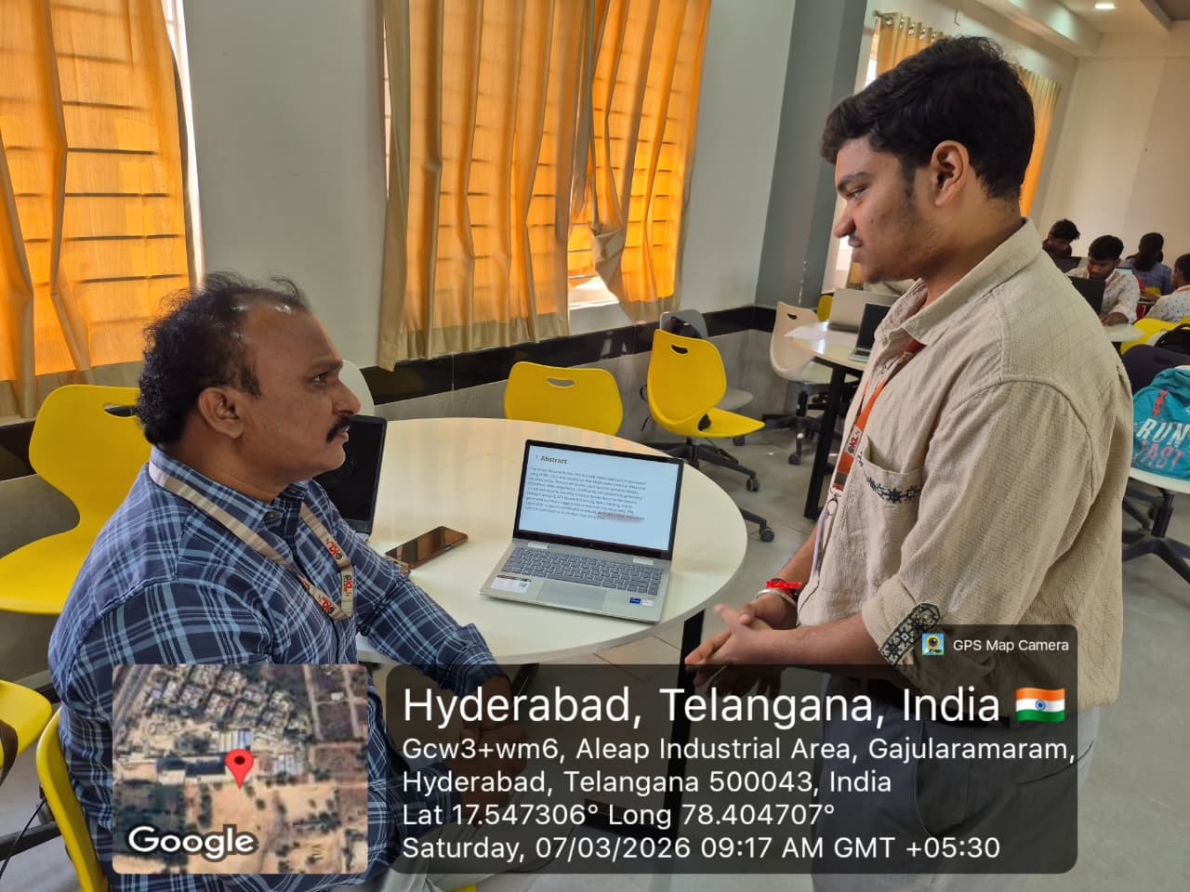
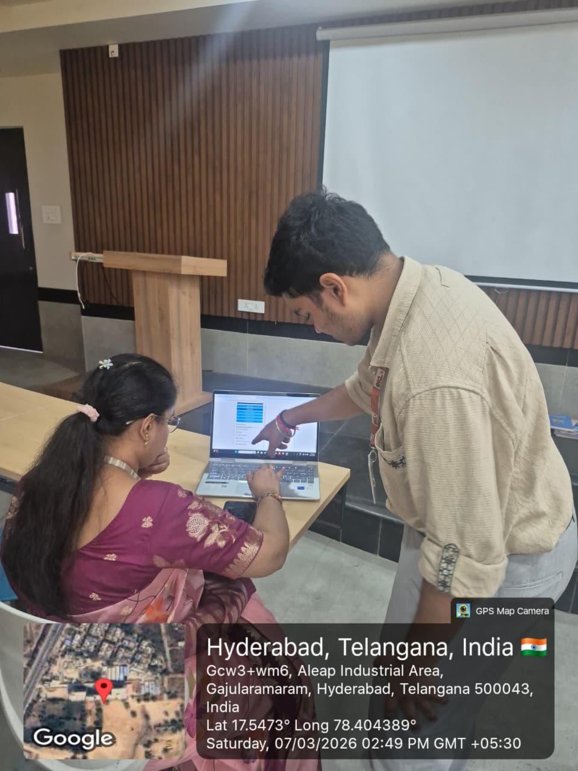
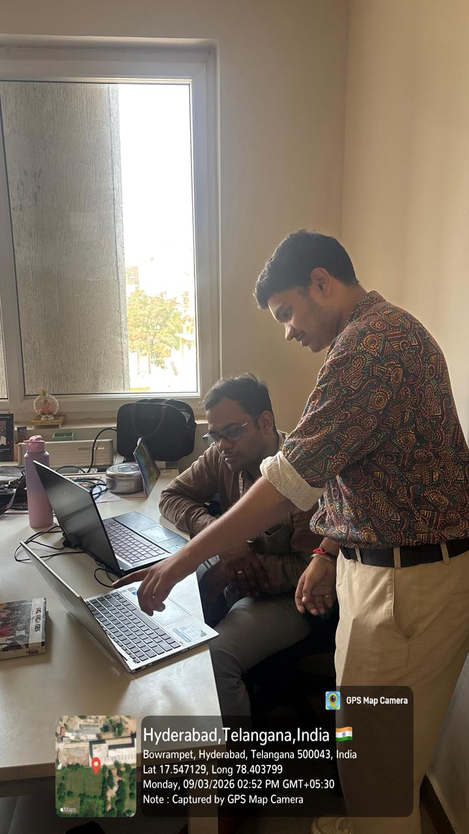
Geo‑Tag Photos
Project presentation geo‑tag photos will be placed here.

Slide 13
THANK YOU

